Slide 1
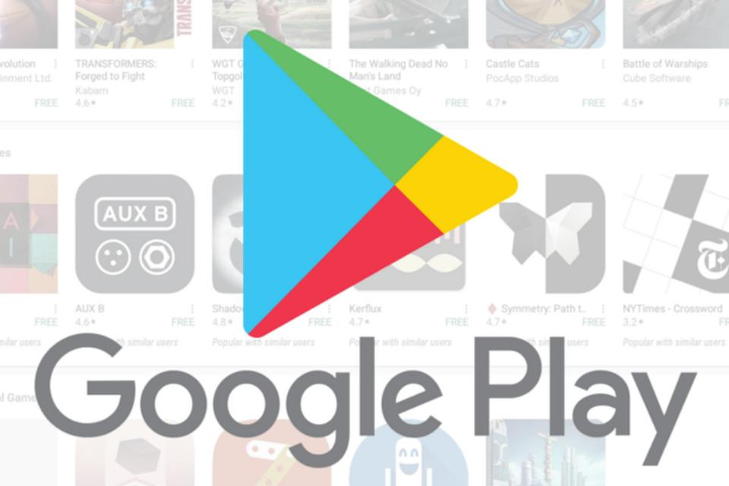
Analysis of Apps in the Google Play Store

Slide 2
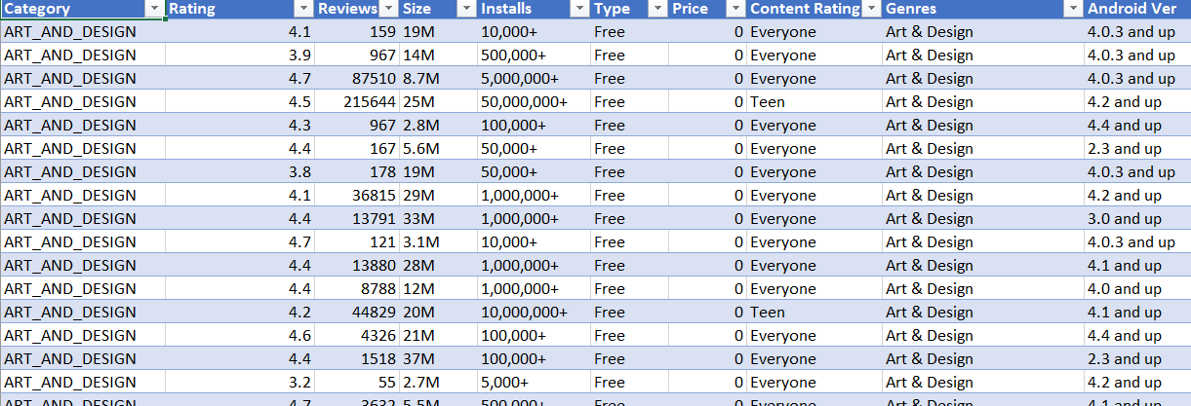
Data Scraping
Collected descriptive information on over 19,721 apps across 17 different categories in the Google Play Store.
Categories included Business, Food & Drink, Books & Reference, Travel & Local, Health & Fitness, News & Magazines, Education, Social, Finance, Medical, and Entertainment.
Scraped app title, category, genre, content rating, number of reviews, app size, number of installs, and price.

Slide 3
Categories
Game , Family , Tools and Medical were the most common categories, accounting for about 11%, 18% ,8% and 3% of the total number of apps in our dataset, respectively.
Beauty was the least prevalent category.

Slide 4
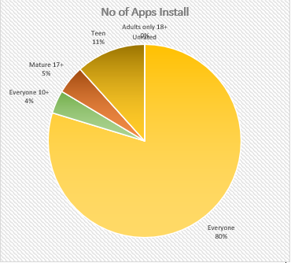
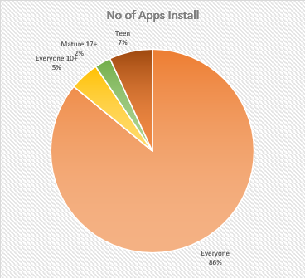
Free vs. Paid Apps(Content Wise)
In Both Paid and Free version of an app, Everyone Content leads. However, In Paid Version there are negligible no of Adult and unrated content.
Free
Paid

Slide 5
Paid and Free Ratio
93% of the total apps on the Play Store were are Free. It means Majority of Apps Are Free.

Slide 6
Free and Paid Apps by Category
The Majority of apps in Family , Game and Tools, as well as Medical categories were free to install.
Family , Game , Tools, Medical as well as Personalization categories had the biggest number of paid apps available for download.

Slide 7
Number of Installs
The Google Play offers a wide range of applications, but most of these apps had been downloaded only by a small number of people. 28% of the apps had been downloaded fewer than 100 times and about 74% of the apps had been downloaded fewer than 50K times.
Among the apps that had been downloaded between 500M to 1B+ times were Instagram, Facebook, Google + and Google News.

Slide 8
No of Apps in Each Genre
Education and Tools has the highest No of Downloads.

Slide 9
Android Version with 4.0 and Above has Support Maximum number of Google Play Store Apps. However , There are many Apps which does not depends on the Android version.

Slide 10
Summary :
By the Analysis, Game , Family , Tools and Medical were the most common categories, accounting for about 11%, 18% ,8% and 3% of the total number of apps in our dataset, respectively.
Beauty was the least prevalent category.
The Majority of the apps in Family , Game and Tools, as well as Medical categories were free to install.
Family , Game , Tools, Medical as well as Personalization categories had the biggest number of paid apps available for download.
93% of the total apps on the Play Store were are Free. It means Majority of Apps Are Free.

Slide 11
Thank you

